Slide 1
Faculty of Engineering Technology
& Research. Isroli, Afwa.

Slide 2
Name | Enrollment no | Roll no
KUSHAL RATHOD | 130840106053 | 68
KEVIN SHAH | 130840106057 | 10
RAJ PATEL | 130840106045 | 03
PARESH PATEL | 130840106043 | 79
KRUNAL PATEL | 130840106039 | 45
MOHAMMAD PATEL | 130840106042 | 07
Guided by
- Mr. Shivang Dabhi
-Miss Ankita Upadhyay

Slide 3
COMPASS SURVEYING
STUDY OF INSTRUMENTS AND AREA CALCULATION

Slide 4
Compass surveying
The principle of surveying is traversing; which involves a series of lines which are connected

Slide 5
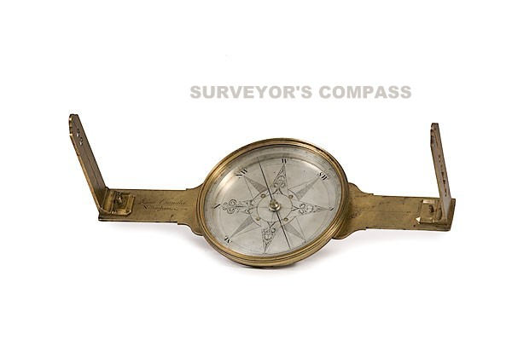
TYPES OF COMPASS
PRISMATIC COMPASS
SURVEYOR’COMPASS

Slide 6
THE PRISMATIC COMPASS

Slide 7
CONSISTING PARTS
Cylindrical metal box
Pivot
Lifting pin and lifting liver
Magnetic Needle
Graduated Ring
Prism
Object vane
Eye Vane
Glass Cover
Sun Glasses
Reflecting Mirror
Spring Brake or Brake Pin

Slide 8
PRISMATIC COMPASS

Slide 9
INSTRUMENTS USED FOR COMPASS SURVEYING
The various instruments used in the compass survey are :
Prismatic compass
Tape
Ranging rods
Tripod
Arrows
Plumb Bob

Slide 10
PRISMATIC COMPASS
Prismatic Compass comprises of a magnetic needle attached to the circular ring made up of aluminum.
The needle is on the pivot and will orient itself in the magnetic meridian
The line of sight is defined by the objective vane and the eye slit, both attached to the compass box.

Slide 11
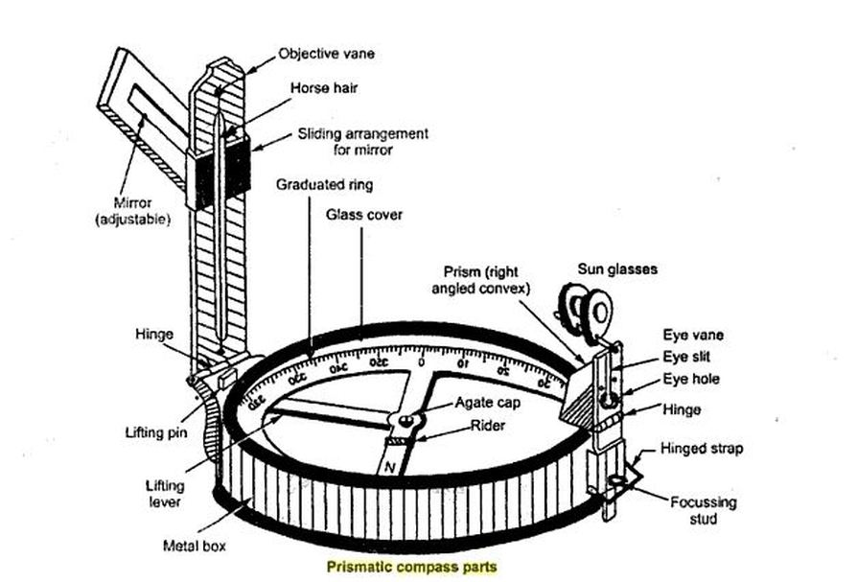
A triangular prism is fitted below the eye slit.
The readings increase in clockwise direction.
The object vane frame can be folded on the glass lid which covers the top at box.

Slide 12
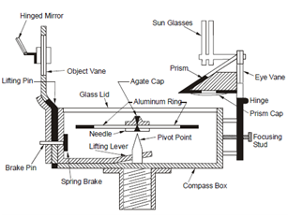
lever which lifts the needle of the pivot and holds it against the glass lid.
When bright objects are sighted dark glass may be interposed in to the line of sight.

Slide 13
Adjustments of Prismatic Compass:
The following are the adjustments usually necessary in the prismatic compass:
Centering
Leveling
Focusing the prism.

Slide 14
CENTERING:
The center of the compass is placed vertically over the station point by dropping a small piece of stone below the center of the compass, it falls on the top of the peg marking that station.
LEVELLING:
By means of ball and socket arrangement the Compass is then leveled the graduated ring swings quite freely. It may be tested by rolling a round pencil on the compass box.
FOCUSSING THE PRISM :
The prism attachment is slid up or down focusing till the readings are seen to be sharp and clear.

Slide 15
THE SURVEYOR’S COMPASS

Slide 16
SURVEYOR’S COMPASS

Slide 17
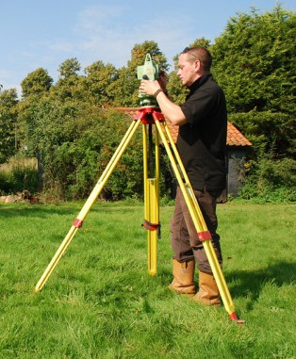
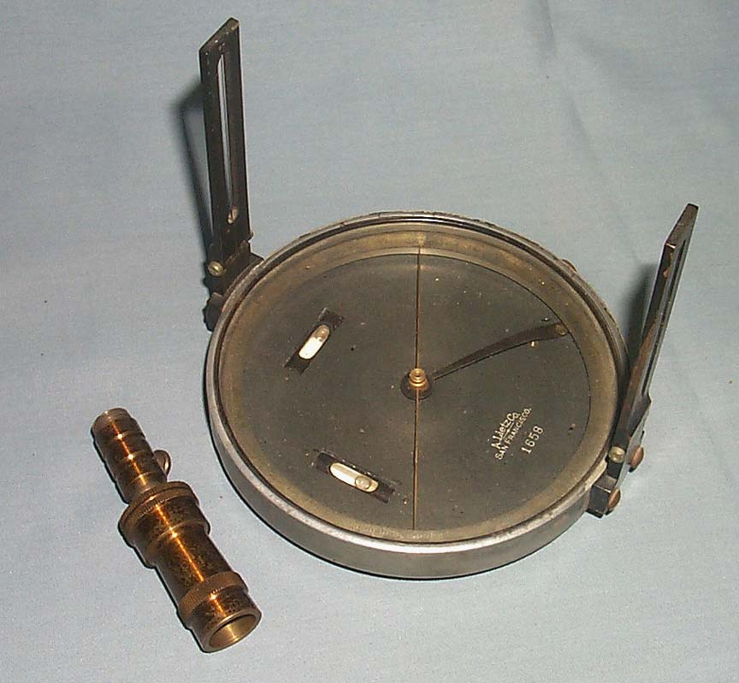
WORKING OF SURVEYOR’S COMPASS
Centering
Levelling
Observing the bearing line

Slide 18
In this type of compass , reading is taken from the top of glass and under the tip of north end of the magnetic needle directly. No prism is provided here . Construction and bearing system of the surveyor’s compass differs from prismatic compass .

Slide 19
TYPES OF MERIDIANS
Magnetic Meridians and Magnetic Bearing
True Meridian and True Bearing
Arbitrary Meridian and Arbitrary Bearing

Slide 20
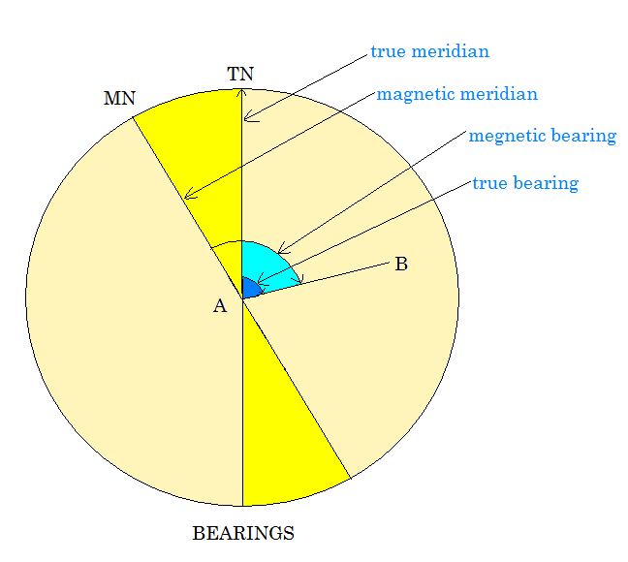
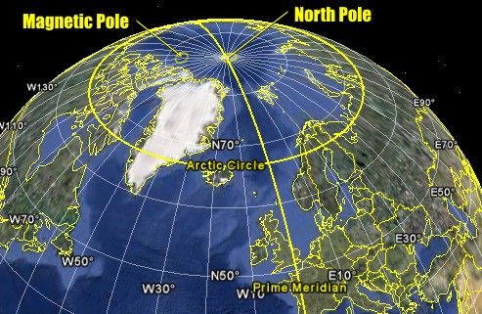
TYPES OF BEARINGS
True bearing
Magnetic bearing
Grid bearing
Arbitrary bearing

Slide 21
MEASUREMENTS OF BEARINGS

Slide 22
REDUCED BEARING [RB]
W.C.B OF ANY LINE | QUADRANT IN WHICH IT LIES | RULE FOR CONVERSION | QUADRANT
0° to 90° | first | RB = WCB | N-E
90° to 180° | second | RB = 180° - WCB | S-E
180° to 270° | third | RB = WCB - 180° | S-W
270° to 360° | fourth | RB = 360° - WCB | N-W

